Slide 1



Figure 1
Metamonada
Opisthokonta
Amoebozoa
Discoba
Rhizaria
Streptophyta
Alveolata
Stramenopila
Rhodophyta
Chlorophyta

Slide 2

Figure 1

Slide 3







Figure 2

Slide 4
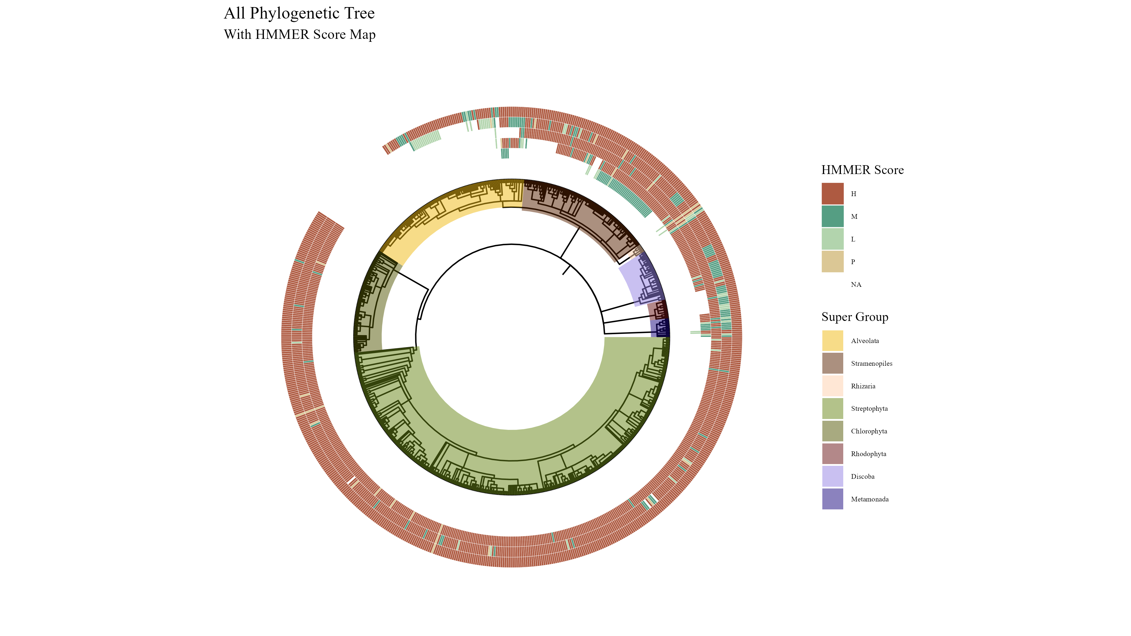
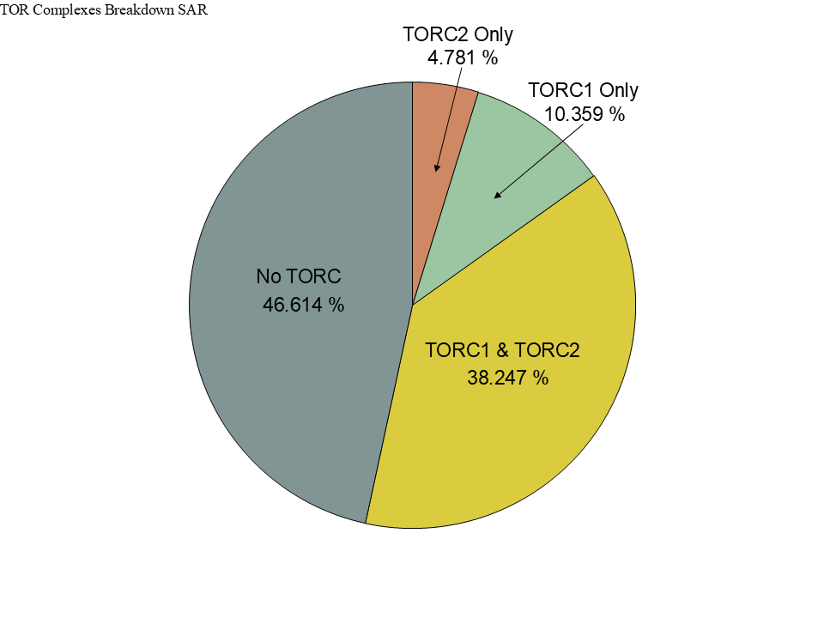
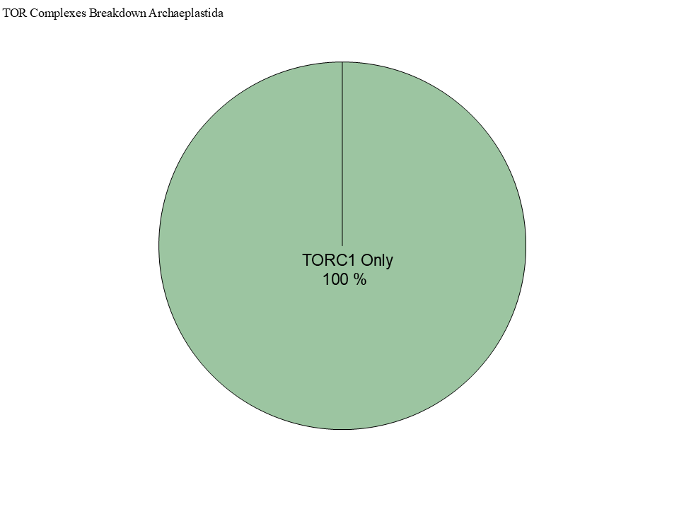
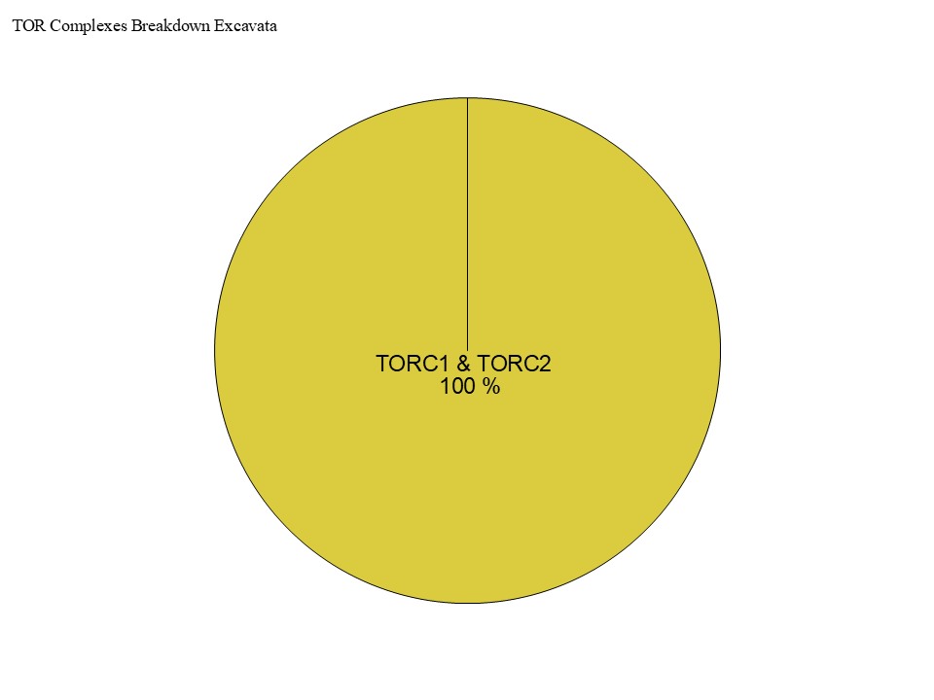
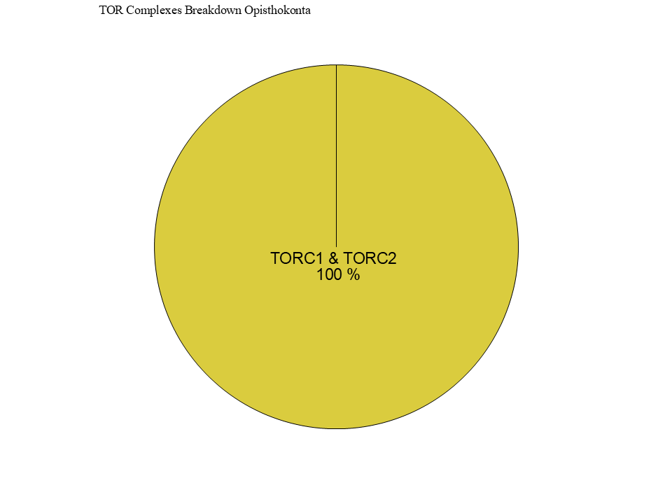
Figure 4

Slide 5
Figure 4

Slide 6
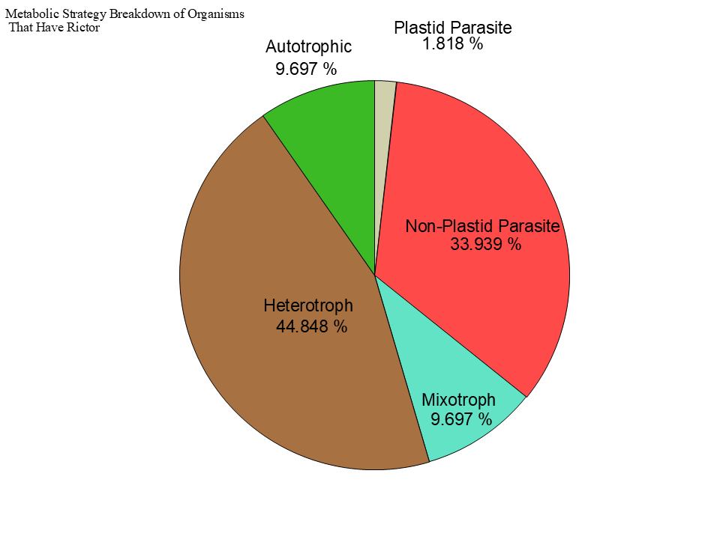
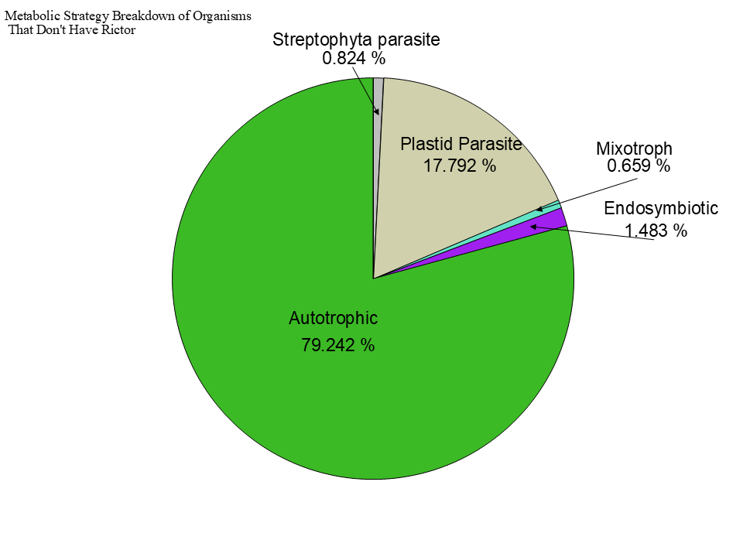
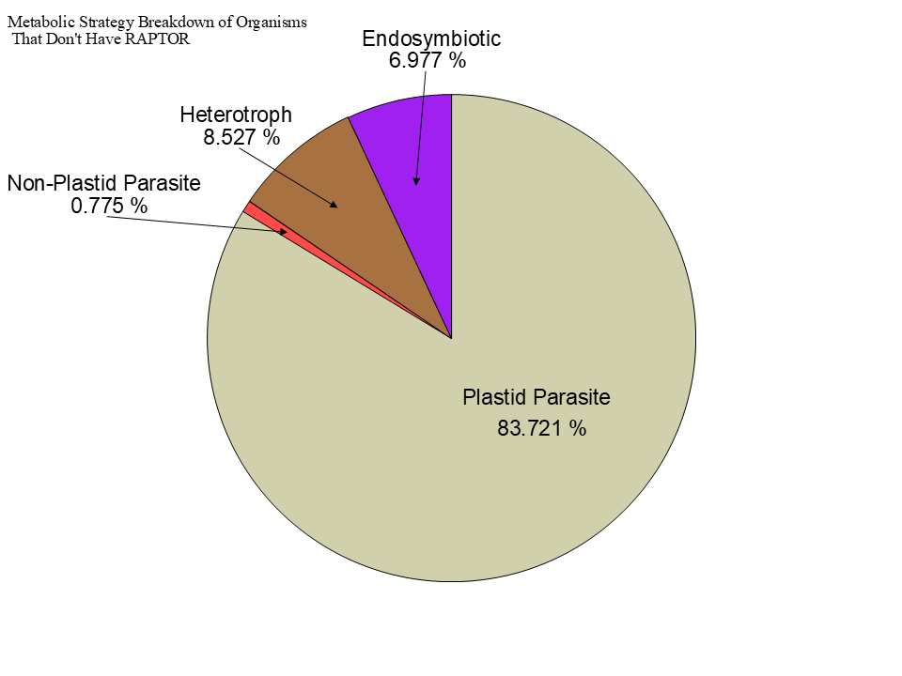
Figure 4

Slide 7


Slide 8


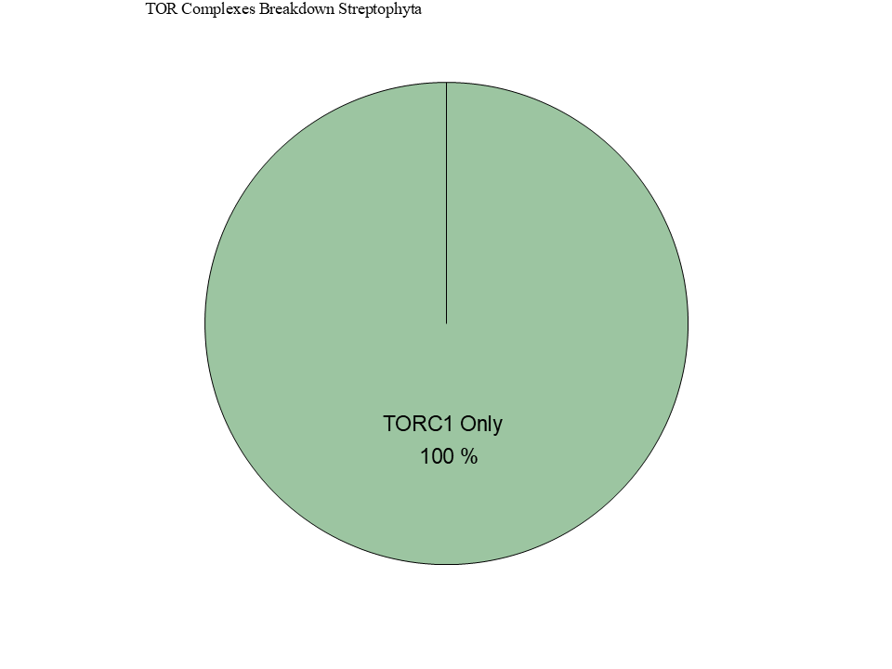
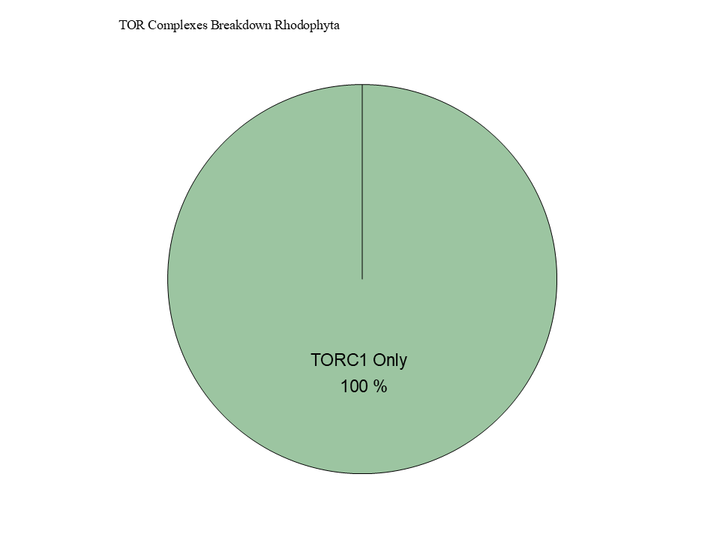

Slide 10





Figure 6

Slide 11
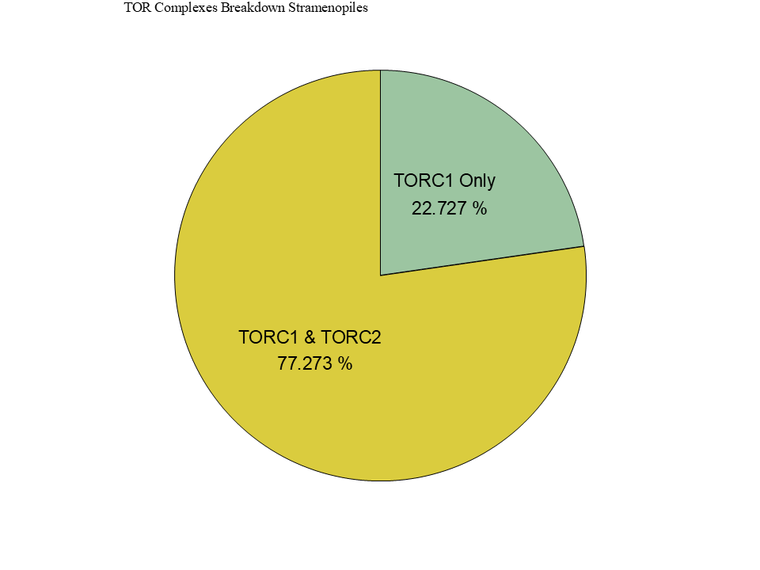
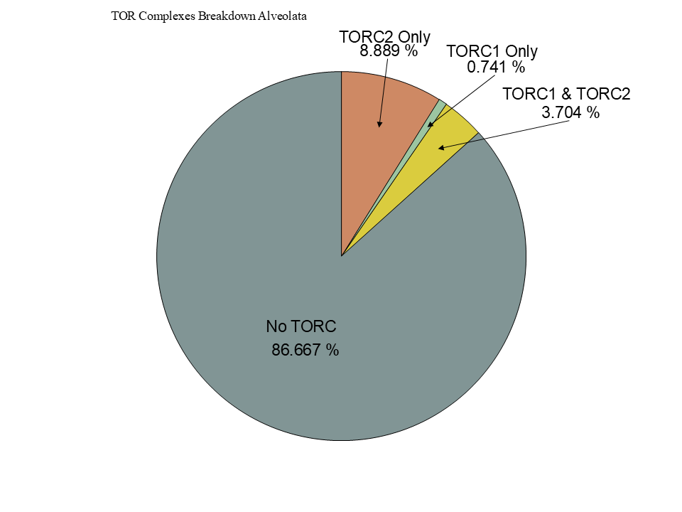
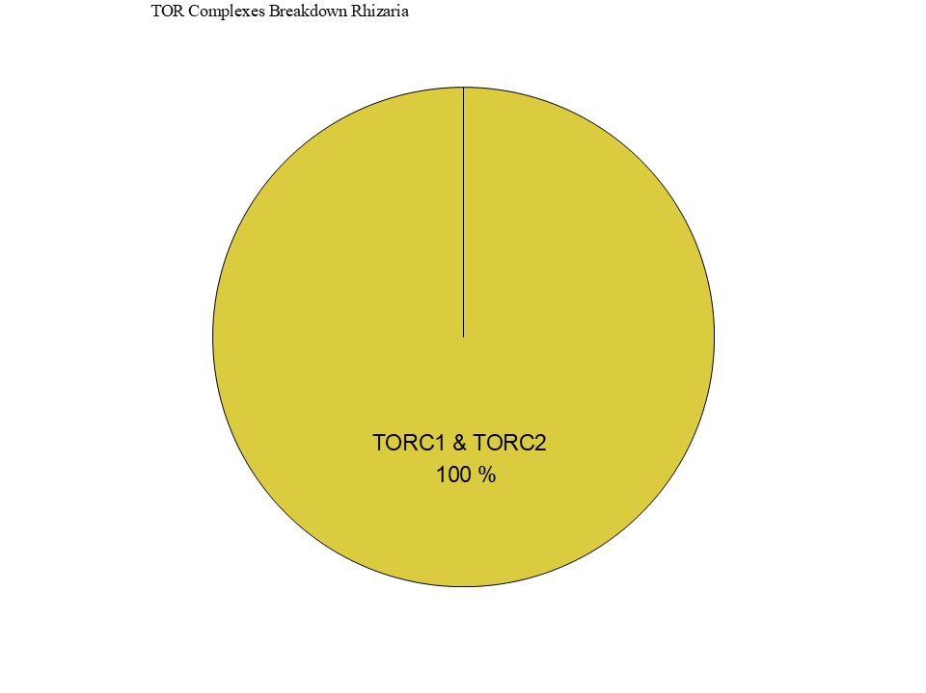
Figure 6

Slide 12



Figure 5

Slide 13
Figure 5

Slide 14


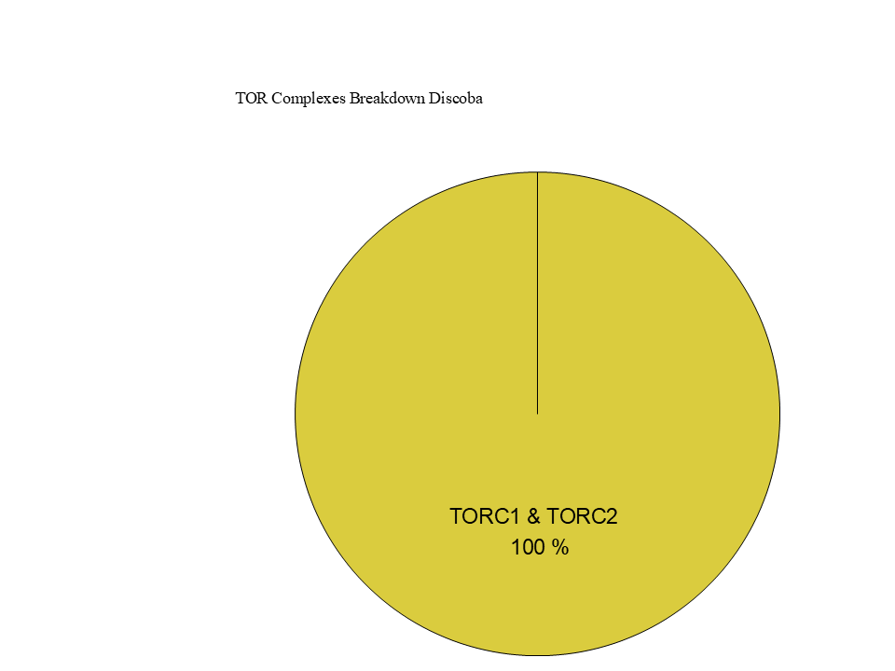
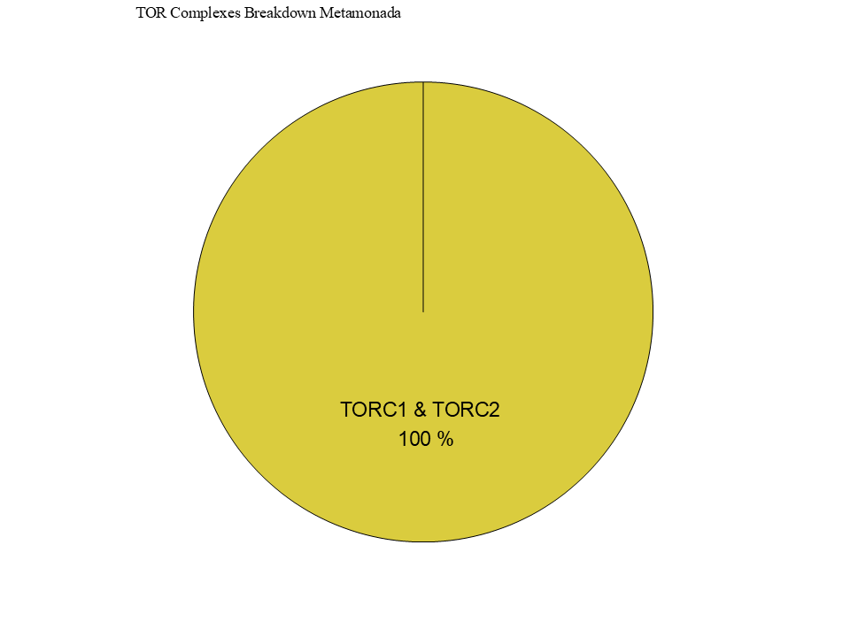
Figure 7

Slide 15










Figure 3
1
1694
RICTORN
RICTORM
RasGEF
Domain5
RICTOR Phosphorylation
ARM Repeats
1
1353
RAPTORN
ARM Repeats
HEAT
ARM Repeats
WD-40 Repeats

Slide 16
Workflow/Pipeline
NCBI/JGI Genomic Information
MSA
Phylogenetic Tree(s)
Results/TOR Complex Patterns
BUSCO/HMMER/BLAST
R Tables & Taxonomy Tables
Graphs/Data Table
SRA /Diamond Alignment
Notes:
We need to add a start point. Have something that asks the question; what organisms have TORC2 Components and TORC1 Components?

Slide 17
SARs Gain of Plastids:
Losses of TOR Complexes
Rhodophyta Endosymbiosis
Phaeodactylum tricornutum
TORC2 Lost
Macrocystis pyrifera
Stramenopila
Nannochloropsis gaditana
Phytophthora sojae
Expected Heterotrophic Ancestor
TORC1 & TORC2 Present
Stramenopile Endosymbiosis
Polarella glaciallis
Vitrella Brassicaformis
Alveolata
Plasmodium falciparum
Tetrahymena thermophila
Alpha-Cyanobacteria Endosymbiosis
Photoautorophy Loss
Paulinella micropora
TORC1 and TORC2 Lost
Bigelowiella natans
TORC1 Lost
Rhizaria
Chlorophyta Endosymbiosis
Plasmodiophora brassicae

Slide 18
Figure 4

Slide 19
Simplified Excavata Gain of Plastids
Chlorophyta Endosymbiosis
Euglenophyceae
Discoba
Kinetoplastea
Eutetramitia, etc.
Expected Heterotrophic Ancestor
TORC1 & TORC2 Present
Metamonada

